Slide 1


From Telemetry to Insights to Decisions
Dr Luke Dicken
Director of Applied AI
Zynga Inc
Notes:
Content Management and Creation to Prevent Churn in the Most Engaged Consumers

Slide 2
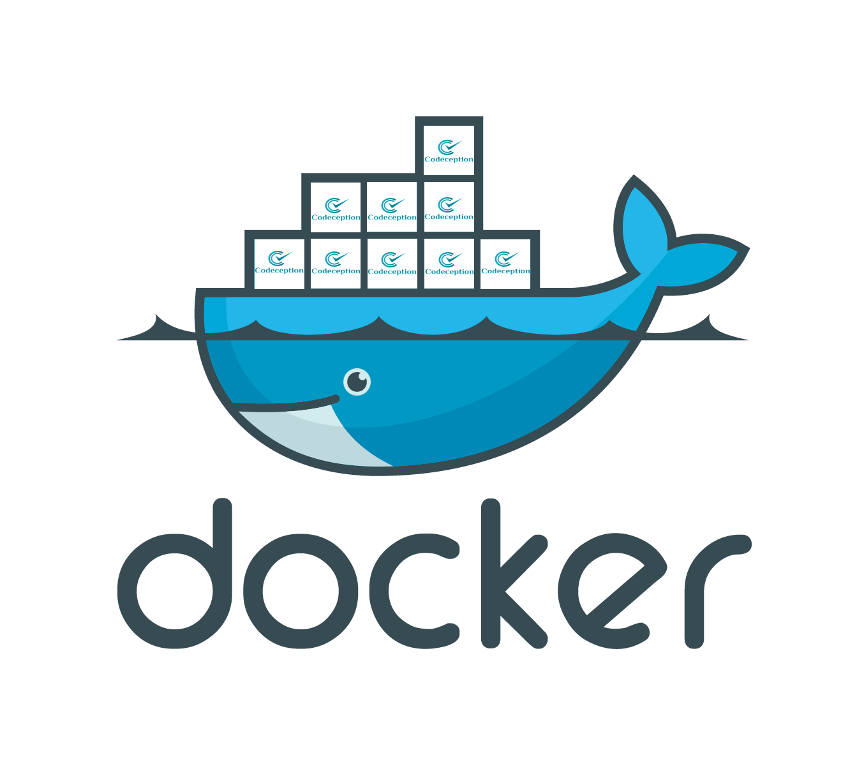



Software Required
Docker
2.0.0.3
https://www.docker.com/
PyCharm
Community Edition
https://www.jetbrains.com/pycharm/
Unity
2019.3.0a3 (webGL Support)
https://store.unity.com/
Git
https://desktop.github.com/
Clone https://github.com/LukeDicken/GameAIWorkshop2019

Slide 3
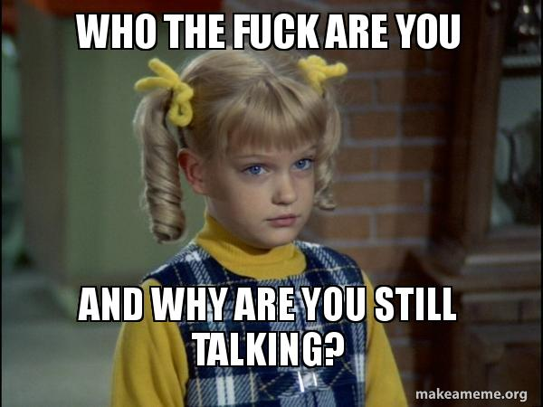
About Me
Recovering Academic
BSc, MSc and MRes in AI
PhD in Planning inside Unity (before it was cool)
Joined Zynga in 2014
Variety of roles over the years
‘17: Director of Central/Strategic Analytics
‘19: Director of Applied AI
Host of the Game AI Show
http://twitch.tv/gameaishow
@gameaishow
Chair of the IGDA Foundation
http://igdafoundation.org/

Slide 4
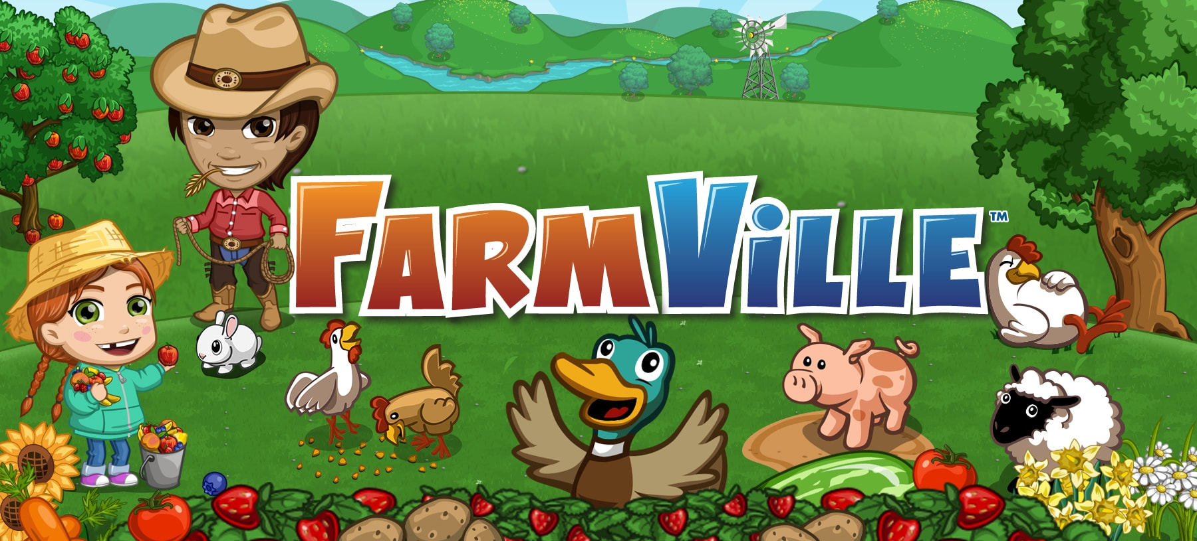
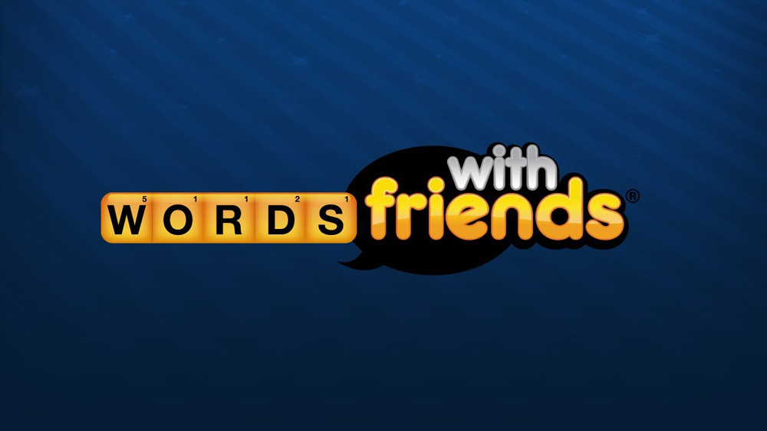
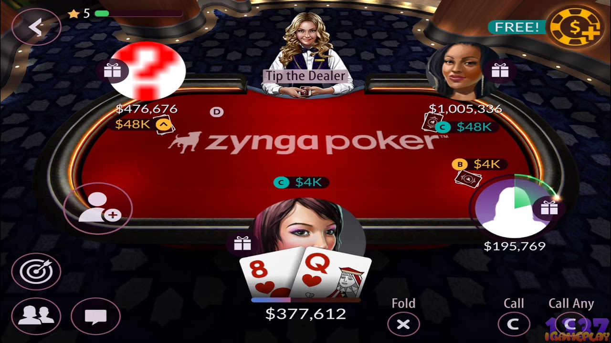
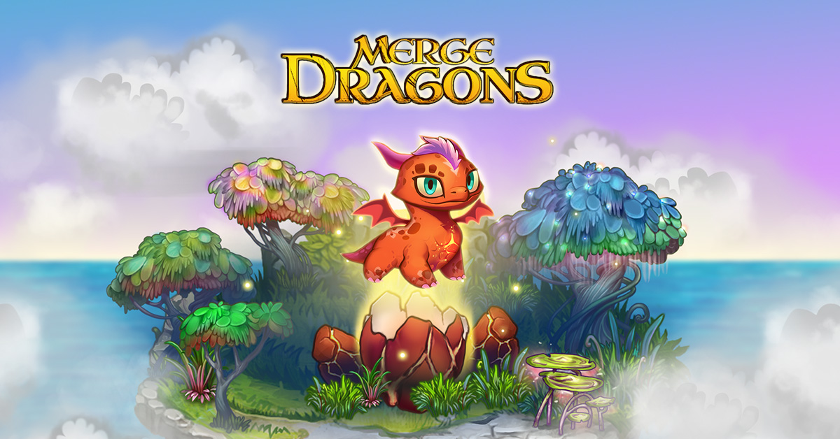
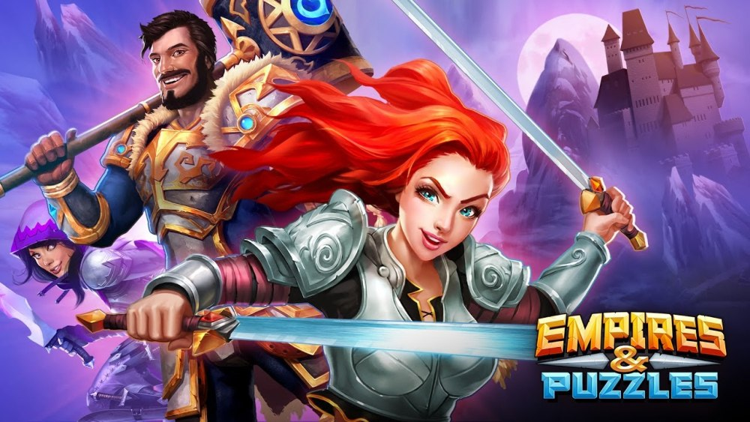

Zynga: Over Ten Years Making Games
Notes:
If you haven’t heard of Zynga, you almost certainly have heard of at least one of our games
We came to prominence on the Facebook platform with titles like Farmville and Words with Friends and Zynga Poker
At a time when games were predominantly shipped in a box to a computer or console that may or may not be connected to the internet, we had the opportunity to pioneer Data-Driven Game Development - on Facebook, our games *HAD* to be online
We could react, iterate and adapt at a speed never seen before - we might push 50 updates to a single game in a single day, A/B testing each component and responding in almost real-time to metric insights
We’ve continued that philosophy as our players have migrated to mobile and broadened our strategy to include a diverse portfolio of over 50 titles, 85 million monthly users and $907 million in revenue in 2018

Slide 5
An Analytics Hierarchy of Needs
Decisions
1
Actionable Insights
2
Aggregated Information
3
Raw Telemetry Data
4
Notes:
Raw Telemetry - this is an actual event being logged. Typically something happens in the game and a record of that is sent to our database. An example might be that a player has started the game.
Next stage of the hierarchy - Information. Having a bunch of session start events logged to a database isn’t very helpful. Typically there’s a process of what I call “refinement” - turning raw analytics-ore (data) into refined analytics-metal (information). For our session events we might perform an ETL process to validate we received all the session start events (no events logged without a corresponding session start), remove accidental duplicates, and roll up an aggregate view of how many sessions each player played on each day
That still doesn’t give us a proper understanding. We need to perform analysis to understand what this information is telling us about our game. Knowing that a player had five distinct sessions isn’t meaningful - is that a lot? Is that a problem? Does this person differ from the norm? Questions like this give us the insight to know what is actually happening inside the game
And finally, we use that insight to make decisions. That might be relatively trivial - we decide that there are no problems! But we might need to take corrective action - and that might be as simple as creating a better plan for re-engaging users, or as complex as fundamentally rethinking a feature within the game because it isn’t driving the metrics we expected.

Slide 6
Buy vs Build
Off-the-shelf solutions exist and are decent-ish*
Unity Analytics
DeltaDNA
GameAnalytics
Generally offer limited access to raw data, usually have built in dashboards and views
Great for basic BI insights
Terrible if you want to mess about in data and do interesting AI things

Slide 7
LET’S BUILD OUR OWN!!!!

Slide 8
In this session you will:
Learn enough about Analytics to be a danger to yourself and others during the game jam!
Specifically:
How/Why to generate telemetry events (client-side)
How to ingest telemetry events (server-side)
How to analyze and generate BI-style insights
Move beyond analysis to modeling and automated decision systems

Slide 9
Telemetry

Slide 10
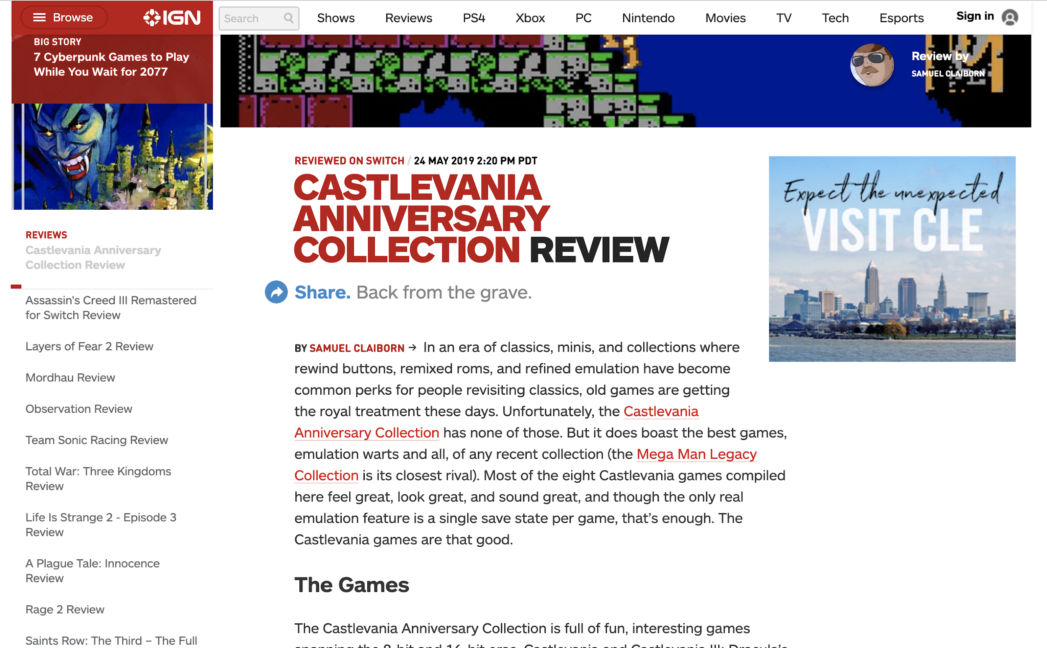
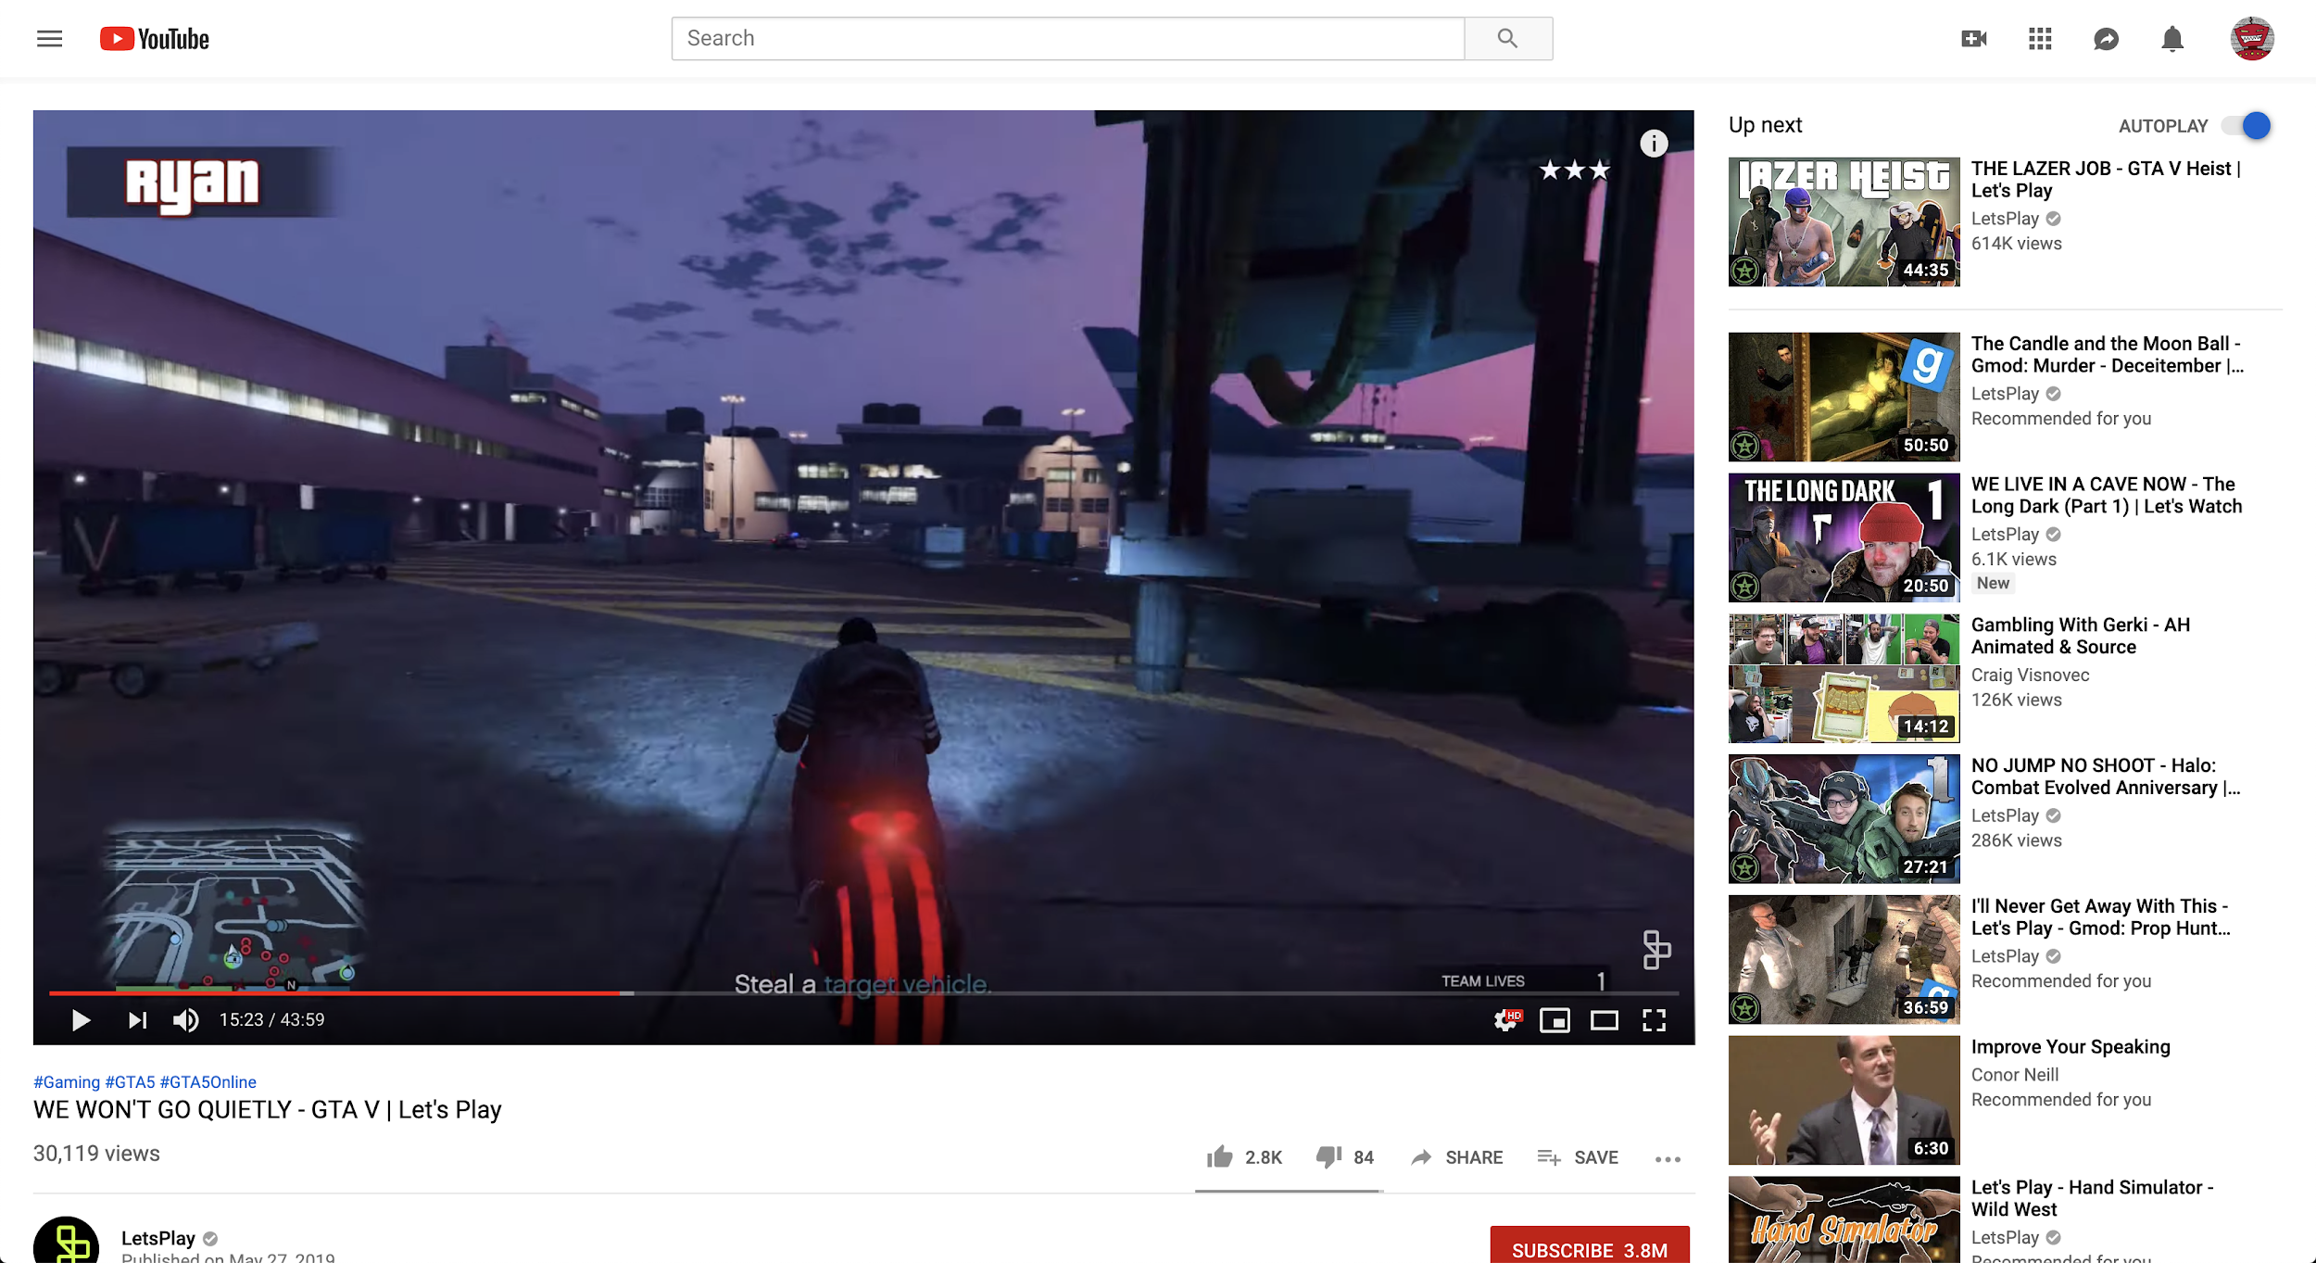
How Do Players Play Your Game?
Notes:
Historically, we put games on disks and sent them off

Slide 11

A Better Way

Slide 12

Let’s take a REST
Notes:
REST -> REpresentational State Transfer
REST is nice because it’s HTTP based
We could spend an hour on REST itself and its philosophy and high brow thinking about stuff. But why.
GET/POST/PUT/DELETE are your core methods. Sort of map to SELECT / INSERT / UPDATE / DELETE in sql
GET means you expect to receive data back
POST means you are sending data
If you’ve ever hacked a website together, you’re probably kinda familiar with these concepts, only now it’s not ONLY happening inside of HTML

Slide 13
The Basics
Hey backend let me tell you about this cool thing that just happened in my game and let’s work out all the details you need to know right now
Hey! A thing happened in the game!
UnityEngine
Backend Blackbox
Game Logic Stuff
Analytics Package
Dear backend. An event occurred and here is the formal paperwork about it:
{“PlayerID”:......... }

Slide 14
Ingestion

Slide 15
Sidebar - Docker
Impossible to over-emphasize how important this tool is in industry
“Build once, run anywhere”
Containers provide host-agnostic lightweight “mini virtual machines”
Docker people would freak out at me using the V M words...
Dockerfile is core component

Slide 16
Listening
Unity is the client - obviously we need a server
The other half of the REST model
Receive a request sent using REST, process it, return a status code
Note that scale is a challenge

Slide 17
Storage
Need to store the data that is being sent
Generally want it to be:
Long term
Queryable
Relational (SQL JOINs etc)
Various ways to do this, no “right” answer

Slide 18
At Scale (AWS)
Elastic Container Service
Kinesis Ingestor
RDMS Cluster
EC2
EC2
S3 Storage
EC2
EC2
Elastic Load Balancing
EC2
EC2
EC2
EC2
EC2
EC2

Slide 19
Simple Architecture
Listen Server
Storage

Slide 20
Insights

Slide 21
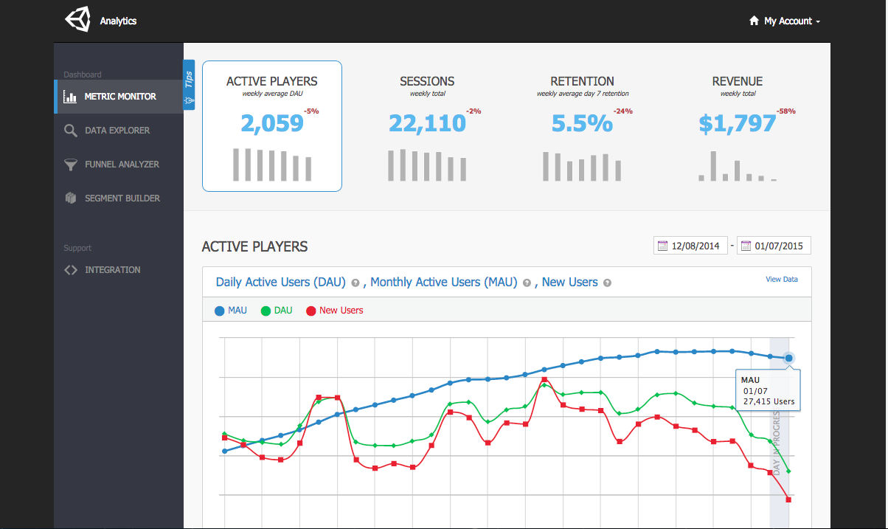
Business Intelligence

Slide 22

Data Cleanliness

Slide 23
Decisions

Slide 24

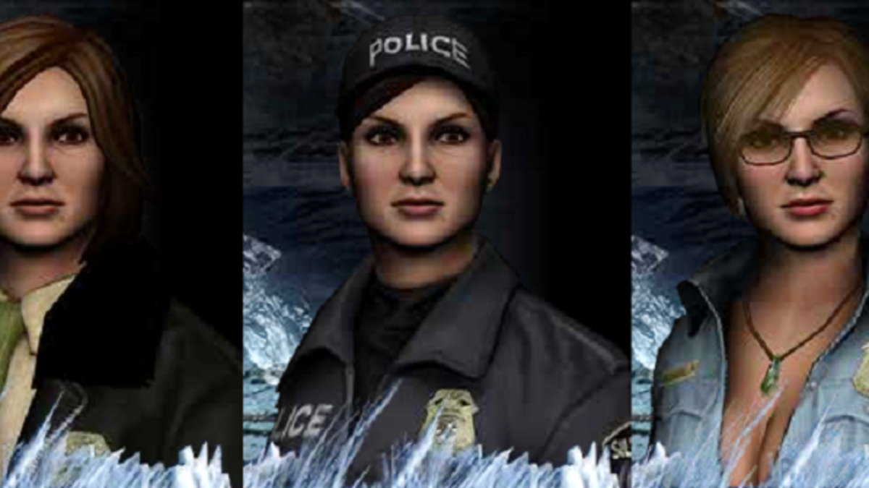

Customizing Experiences

Slide 25

(I really hope you were paying
attention to that “Required Software” slide)

Slide 26
Software Required
Docker
2.0.0.3
https://www.docker.com/
PyCharm
Community Edition
https://www.jetbrains.com/pycharm/
Unity
2019.3.0a3 (webGL Support)
https://store.unity.com/
Git
https://desktop.github.com/
Clone https://github.com/LukeDicken/GameAIWorkshop2019

Slide 27
Ingestion (Python)
At the end of this section:
Created a simple ingestion service
Familiar with Python REST API development
Understand basics of logging and queryable storage
Very rough understanding of Docker

Slide 28
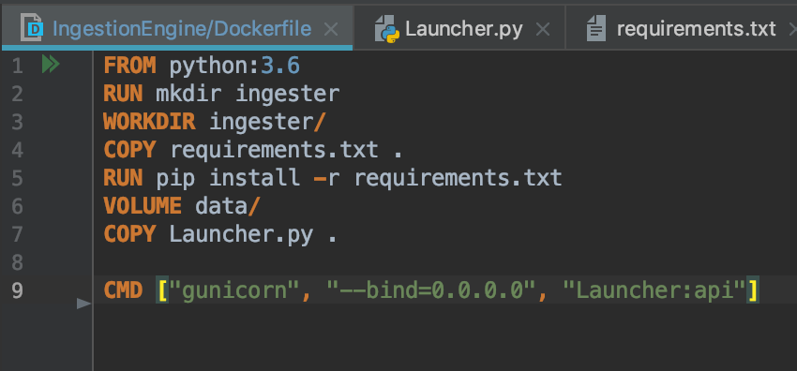
Dockerfile Deconstruct
FROM starts an inheritance system. Here we use a standard Python 3.6 image that’s the official image
RUN a specific command inside the container. In this case we make a new director on the container’s filesystem
WORKDIR changes the working directory - very BASH-ish
COPY takes a file from the local filesystem and copies it into the container’s filesystem
RUNs a command to use the file we just moved into the container to set up the python environment
VOLUME sets up a binding point within the container filesystem. Allows you to assign a folder at runtime and persist data outside of the container
COPY the Python script into the container
CMD that the container will run. gunicorn will start a listen server and sit running, keeping the container alive

Slide 29
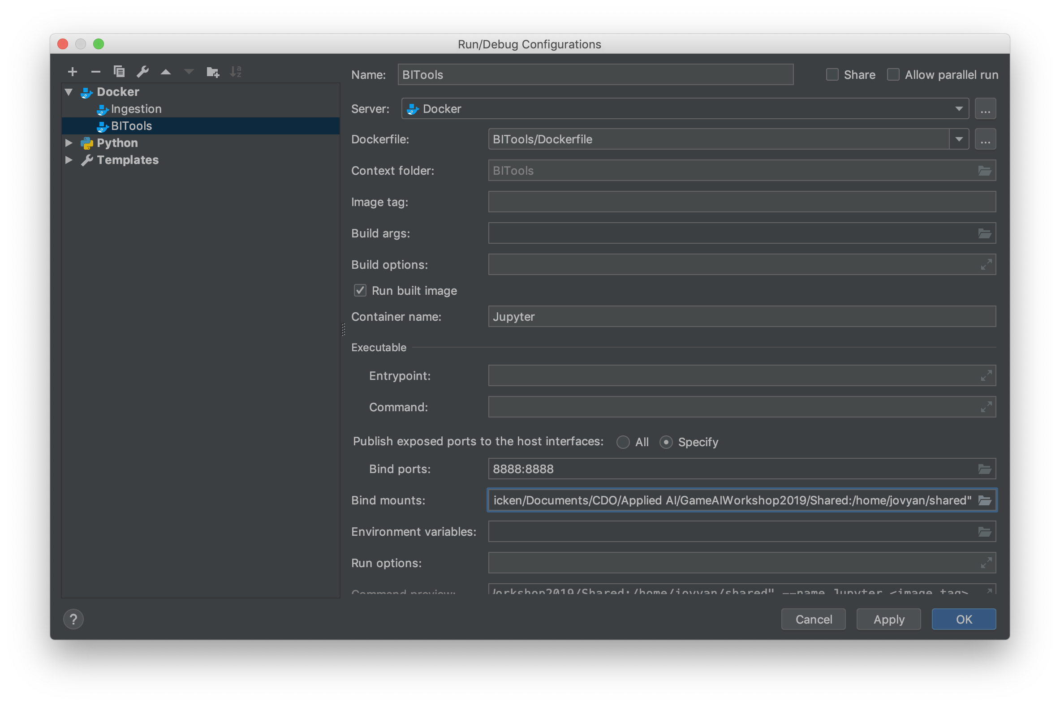
Docker Ingestion Setup
This piece WILL need changing. It assigns a folder on your local filesystem to a specific VOLUME within the container.
Set this to the Shared/ folder within the repo on your local filesystem
First number is the port you want on your local machine then a colon then the exposed port that your system is listening on within the container

Slide 30
Recall: REST

Slide 31
Ingestion Microservice
We use the Python package Falcon as a lightweight REST API
We use gunicorn to make it scalable
Formally “Falcon is WSGI compliant”
Threading for listening. Kinda.
Every REST resource is its own class with listeners for core REST protocols
on_get(self, req, resp)
on_put(self, req, resp)
Wire them up using routes
api.add_route('/status', Status(sql))

Slide 32
Data Model
players
installTime | timestamp | Timestamp of the install event
playerID | varchar(50) | Player ID registered
counters
statTime | timestamp | Timestamp at server
sessionID | varchar(50) | Session ID
playerID | varchar(50) | playerID
counterName | varchar(50) | Name of counter fired
primaryParameter | varchar(50) | Primary (querying) parameter
parameterBlob | varchar(250) | Remainging (non-querying) parameters
sessions
statTime | timestamp | Timestamp on server when received
sessionStartTime | timestamp | Timestamp on client when fired
playerID | varchar(50) | PlayerID
sessionID | varchar(50) | Assigned SessionID

Slide 33
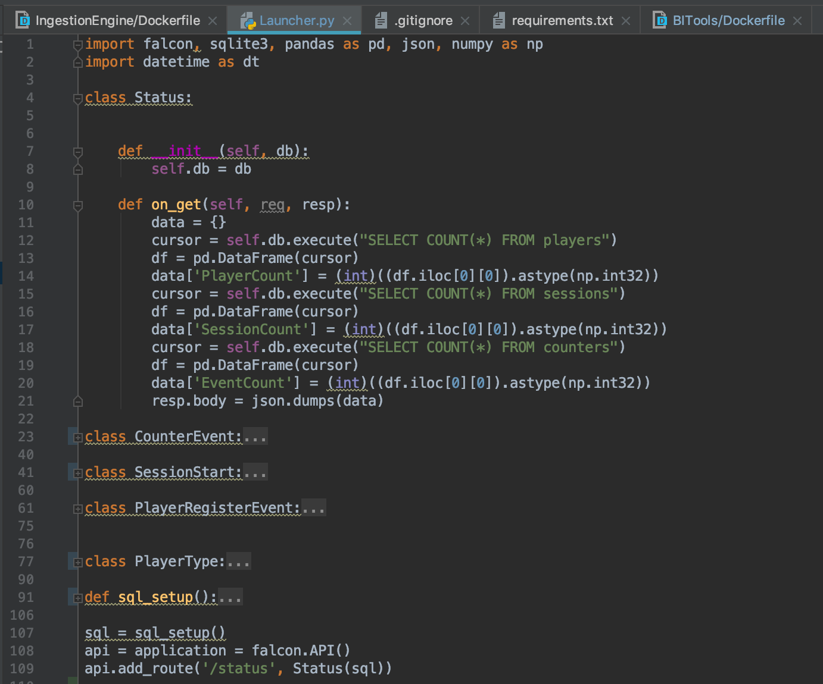
Example: GET /status

Slide 34
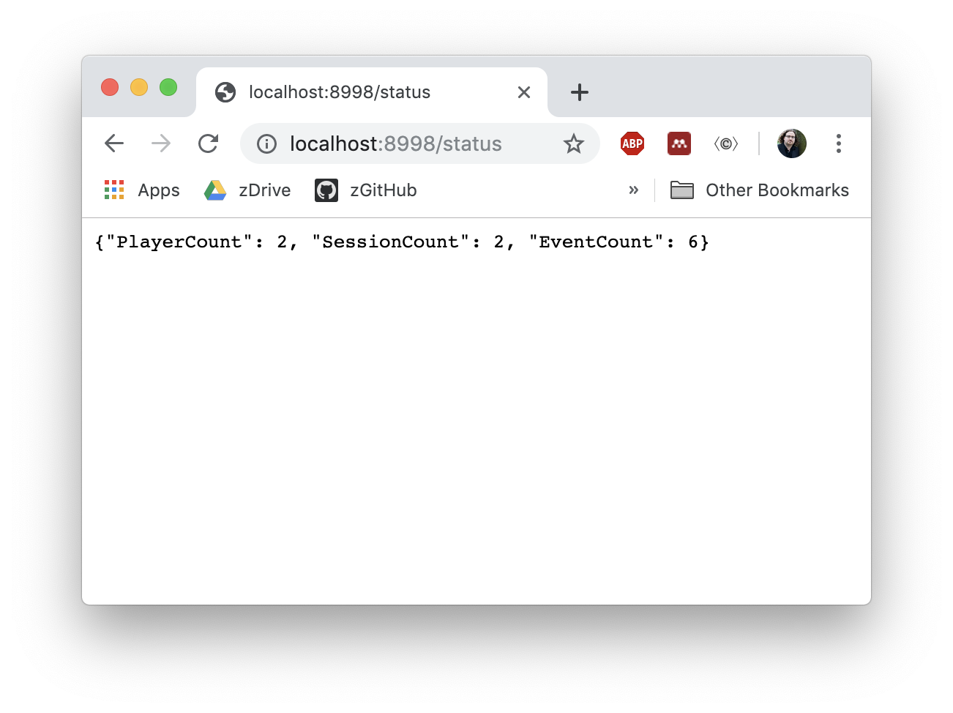
Example: GET /status

Slide 35
Debugging an API
Browser - just ping the service
httpie - simple python command line system
Postman - graphical client for polling REST APIs

Slide 36
Hands On
Complete methods for
PlayerRegisterEvent on_post
SessionStart on_post
CounterEvent on_post
Add them to the api routes at
‘/newPlayer’
‘/sessionStart’
‘/counter’
We’ll take up to 30mins on this part and then move on

Slide 37
Logging Telemetry (Unity)
At the end of this section:
Created a simple logging script in C#
Leveraged Unity’s native UnityWebRequest class for REST calls
Instrumented a basic Unity project with telemetry events

Slide 38
Recall: The Basics
UnityEngine
Game Logic Stuff
Analytics Package

Slide 39
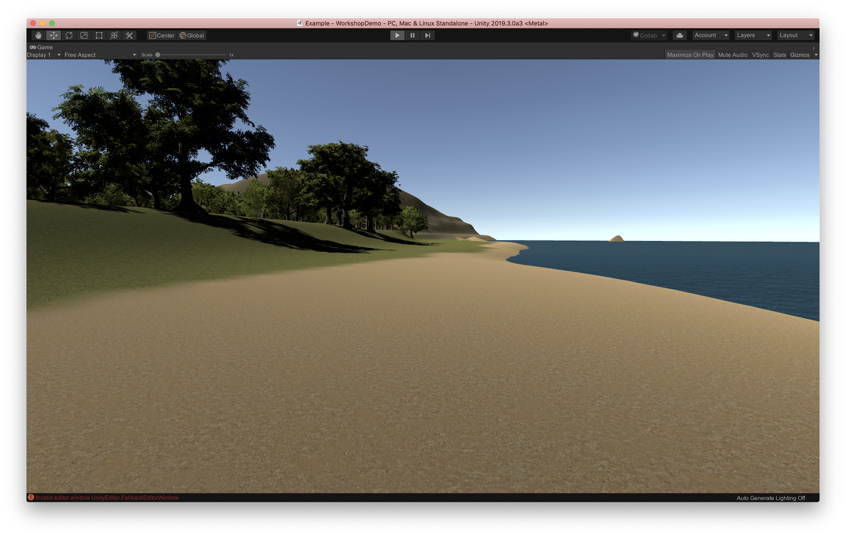
Unity Demo Scene

Slide 40
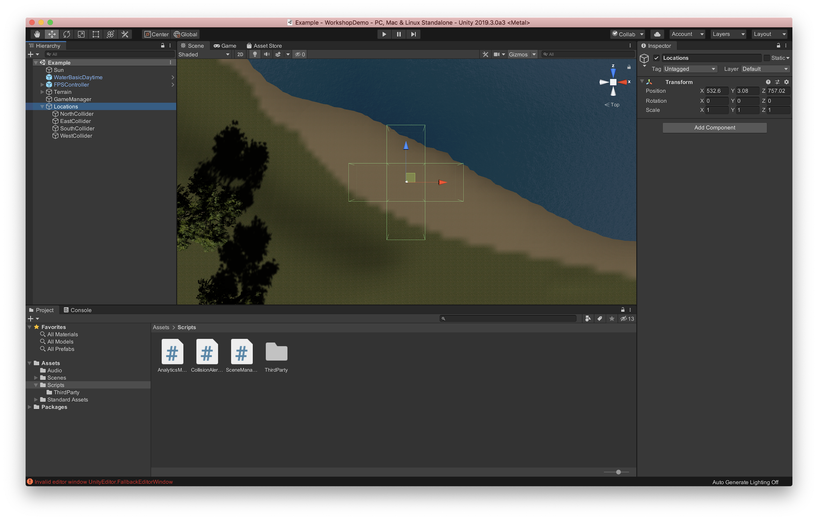
Unity Demo Scene

Slide 41
AnalyticsManager.cs
Notes:
Core script that manages interaction with the backend
Majority of package is static
singleton -ish pattern, prevents searching the scene for the AM GameObject
Firing the event needs to be asynchronous
Leverage Unity’s Coroutine system
Waaaaay out of scope to discuss here. It’s like multithreading. But not.
We want to fire multiple types of event
The changes are primarily in the data payload and endpoint
Lots of code reuse possible here - maintainability++
Note that in the case that the backend is unreachable, we could/should disable this whole system

Slide 42
Telemetry
Things we’re going to care about today:
New Players
http://localhost:8998/newPlayer
Session Start
http://localhost:8998/sessionStart
Collision Events (One kind of “custom” event)
http://localhost:8998/counter

Slide 43
SceneManager.cs

Slide 44
CollisionAlerter.cs
Notes:
Unity physics system allows for triggering scripts based on collision
Attach to the GO that has the collider/trigger
OnTriggerEnter() fires the appropriate piece of code
Prepare a custom event payload, and transmit using the AM

Slide 45
Analysis (Python)
At the end of this section:
Basic data manipulation in Python
Basic visualisation and analysis

Slide 46
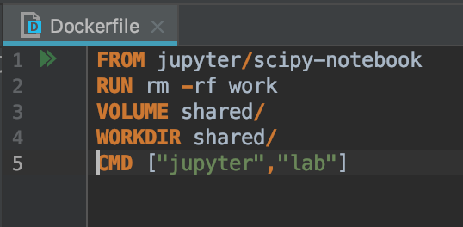
Back to Docker

Slide 47
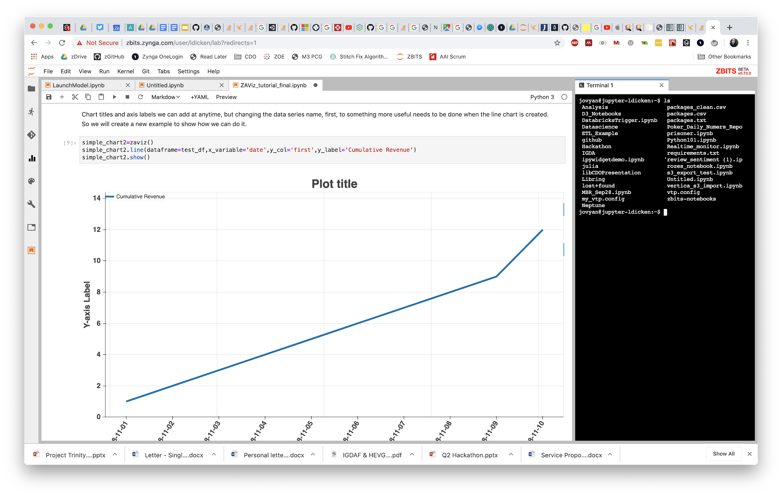
Jupyter Notebooks / JupyterLab
Notes:
Reasonably robust IDE for Python analysis
Allows visualization and code inline - and markdown if you want to add thorough explanations

Slide 48
Hands-On
Graphing with Pandas/Matplotlib
Launch the BITools docker image
From the console, copy the token provided
Open up the Analysis.ipynb notebook in Jupyter

Slide 49
Decision Making (Python, Unity)
At the end of this section:
Understand how to productionalize “analysis as a service”
Use this to customize ingame content at runtime

Slide 50
Machine Learning in Python
Python is super-popular for ML stuff
Lots of libraries provide functionality
numpy/pandas are your core workhorses for data manipulation
Can go deeper into basic modeling with scikit-learn
More bleeding edge systems like Tensorflow go further

Slide 51
Sidebar - ML at Scale
We probably won’t deal with Big Data this week
Hundreds, even thousands of players don’t generate large datasets
A 6 month analysis might cover 10s of millions of users, 10s of billions of records
We keep a 122gb EC2 instance live at all times for ad-hoc analysis
Multiple large Spark clusters perform our heavy lifting
“It’s not Big Data until you find yourself needing to write highly memory optimized code to fit it in 100gb of RAM”

Slide 52
Sending Information Back:
Extending the Telemetry Microservice
Implement the PlayerType class’s on_get() method
Count the number of sessions for a given PlayerID
Reply with a JSON object where “configValue” is set to count(sessions) % 2
Note that this is a dumb model
I’m not here to show you fancy algorithms
This session is about building the pipelines - implement all the stuff you’ve been shown this week or new stuff inside them

Slide 53
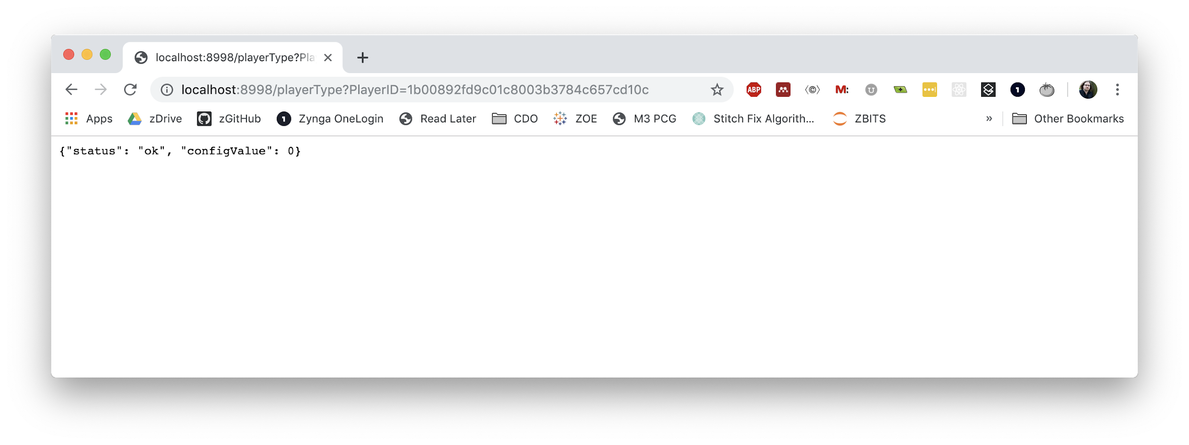
The “Model” Payload

Slide 54
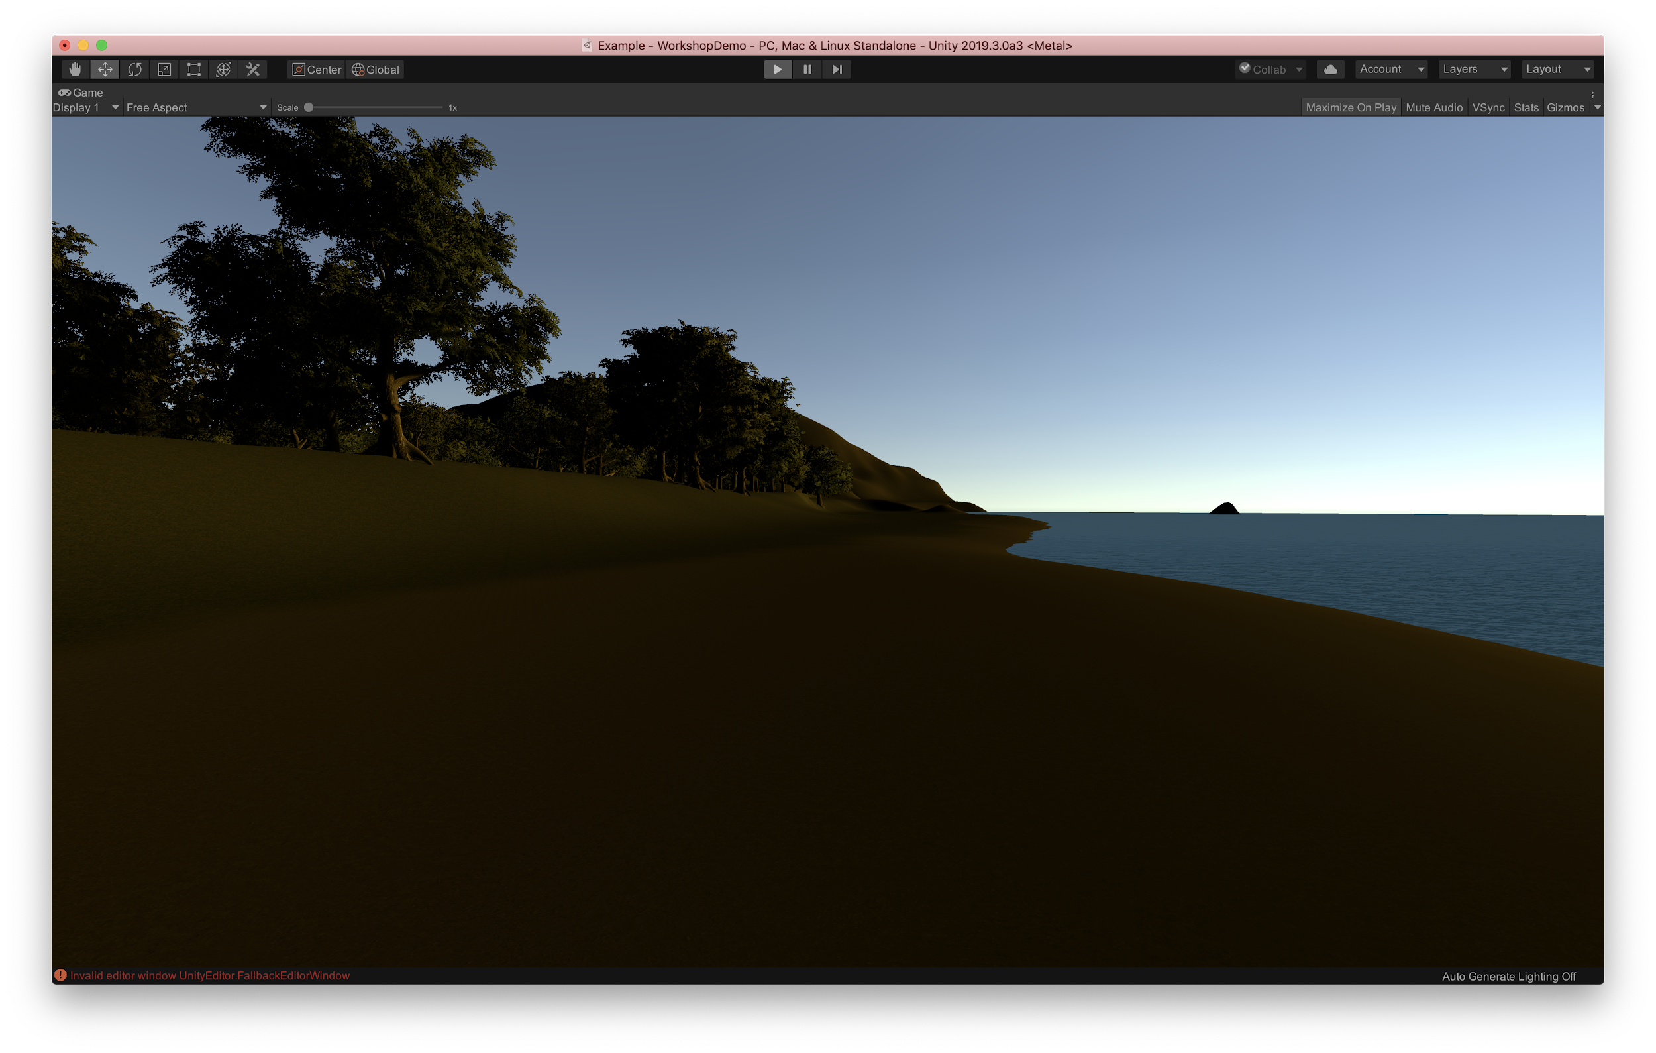
Ingesting Insights Client-side: SceneManager.cs

Slide 55
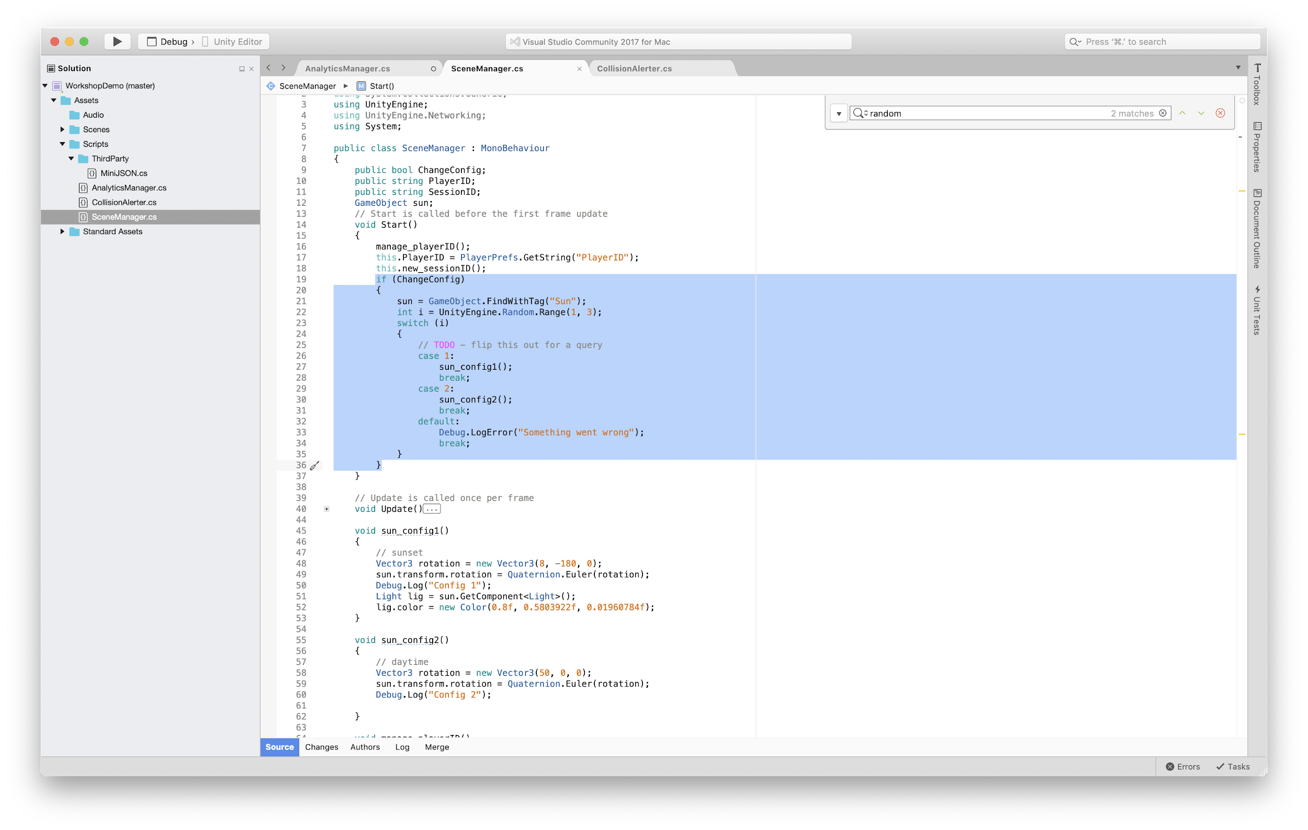
Managing Configurations

Slide 56
Hands On
Change SceneManager.cs to call AnalyticsManager.getConfig()
In AnalyticsManager.cs implement _getConfig()
You’ll need to leverage a callback into the SM class
In the callback, parse the resulting payload with MiniJSON
Gotcha: int config = (int)((long)parameters["configValue"]);
When complete, you should alternate sunset and day configs on each play
Let’s take… however long we’ve got left on this

Slide 57
Building Further
Easy to see how to extend this client-side
Create new custom components to fire additional events
Add them to the relevant GameObject, wire up the trigger event
Done
Easy to see how we add additional core telemetry server-side
Decide on a data model
Wire up the Python class and relevant methods
Add relevant routes
Easy to see how to make more robust models
Set up additional GET endpoints
Implement the logic

Slide 58
Summary
Knowing what happens inside a game is key to running a business
How much money from how many players
You can do waaaaay more with it
Games can dynamically adjust based on the output of models
AI Managements systems are driven by Insights
Which are power by Analytics
You can now build your own (shitty) Analytics tech stack!
This won’t scale super well
It’s not super robust
It’ll ...probably… work for the Jam

Slide 59

Before You Go:
IGDA Foundation Scholarships
Attend GDC
Free pass and travel funding
Exclusive opportunities all week
Large Alumni community
Programs
IGDA Scholars
Velocity
Next Gen Leaders
Eric Dybsand Memorial AI Award
Contact
http://igdafoundation.org/
@IGDAFoundation

Slide 60
Questions?
ldicken@zynga.com
http://analytics.zynga.com/
@LukeD | @GameAIShow

